Slide 1



Project Name:
Comparison of death cases reported in different states of the USA
for Influenza, Pneumonia, and COVID-19,
between 2020 and 2023 for different age groups.
Was it a big deal even...
Since the Pandemic rapidly evolved contradictions took place immediately.
Many people were not getting enough attention in treating other deadly respiratory illnesses other then COVID-19…
Nowadays we have plenty of data around it to study.
Luiza Novytska. Class DA 621, UNLV, 2024

Slide 2
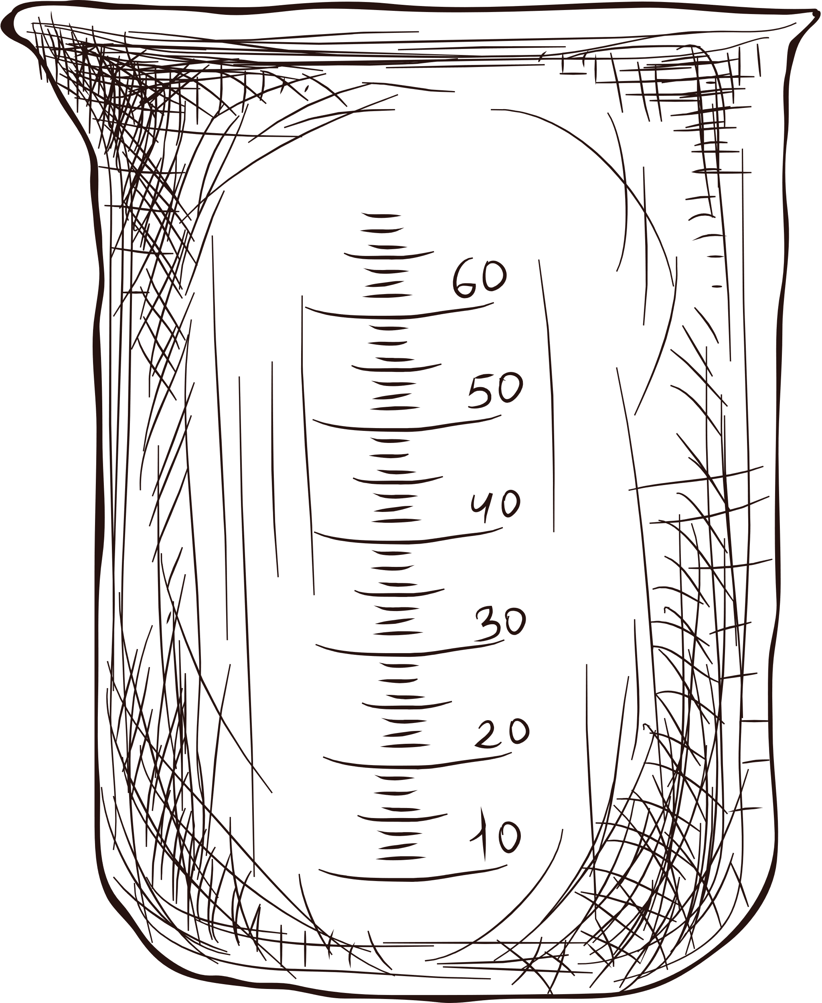


Project
Overview
3 most severe and life-threatening respiratory illnesses are under our attention today:
Influenza, Pneumonia and COVID-19
They all put together into one data report “Provisional death counts for influenza, pneumonia and COVID-19” for years 2020 - 23, presented by the Federal website www.data.gov.

Slide 3

Project
Scope
Using Python programming language to:
1) plot 3 independent graphs to see the trends of COVID-19, Influenza and Pneumonia through the years.
2) combine them in one graph for visual comparison.
3) provide with bar chart according to each US state.
Provide statistics data and conclusions along.

Slide 4
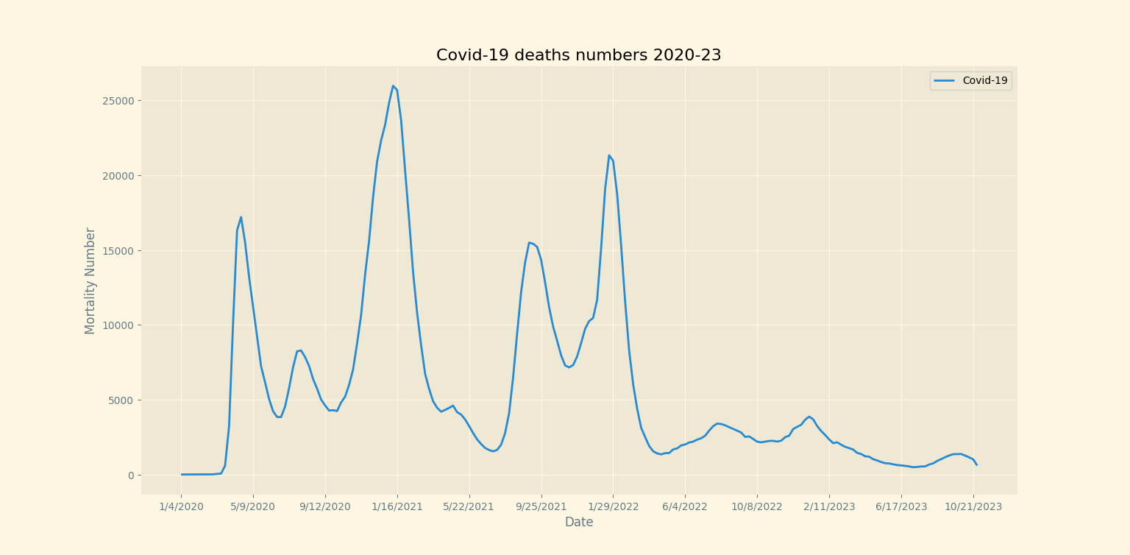
1.1) Analyzing results for COVID-19
Mean
5757
Median
3239
Mode
[0.0, 6.0, 2194.0]
Range
25974
IQR
6454
Variance
Population
36102375
Sample
36283794
SD
Population
6008
Sample
6023

Slide 5
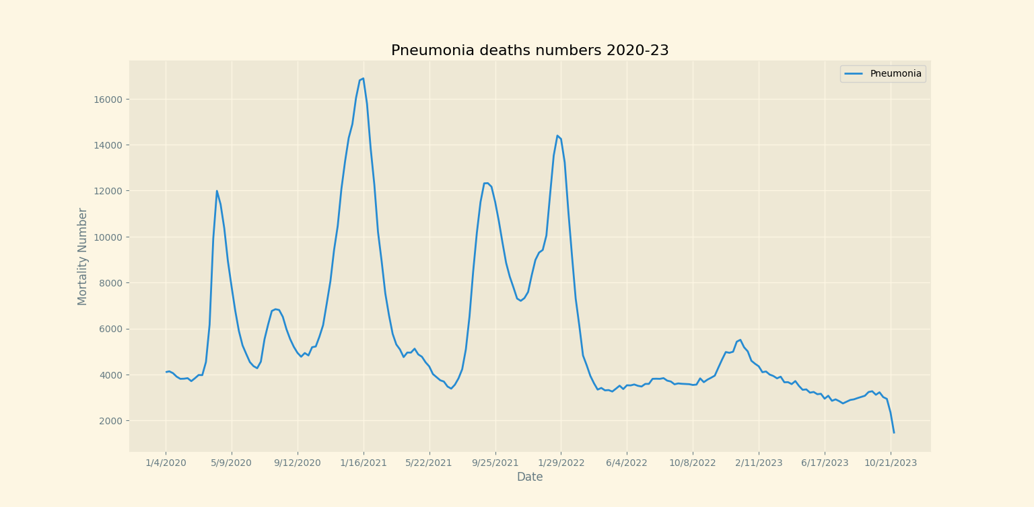
1.2) Analyzing results for Pneumonia
Mean
5895
Median
4534
Mode
[3810.0]
Range
15450
IQR
3662
Variance
Population
11150872
Sample
11206906
SD
Population
3339
Sample
3347

Slide 6
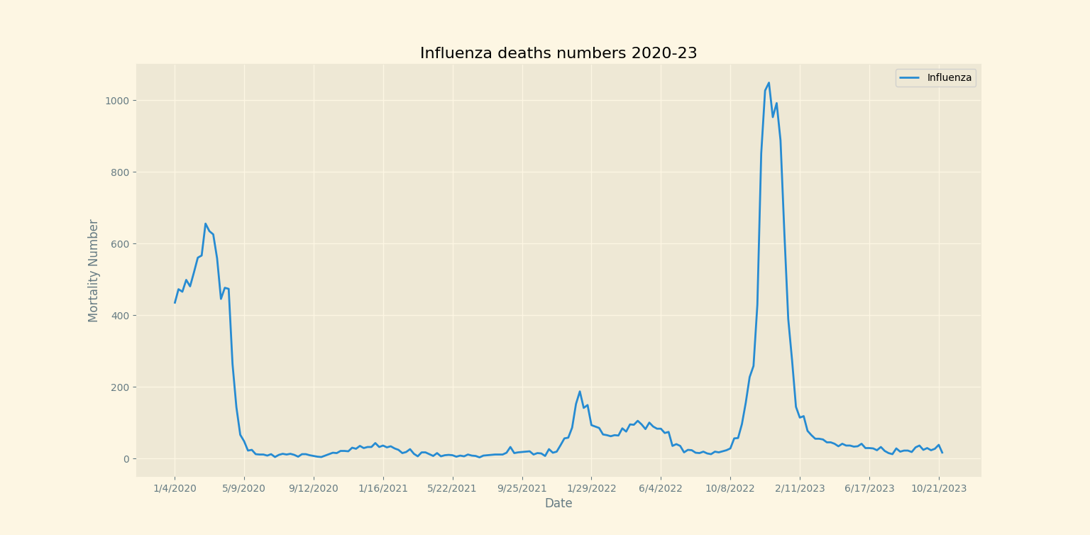
1.3)Analyzing results for Influenza
According to this graph, Influenza has insignificant numbers compared to COVID-19. At most is a little more than 1000 people. Which putting it out of competition for statistics and further analysis.

Slide 7
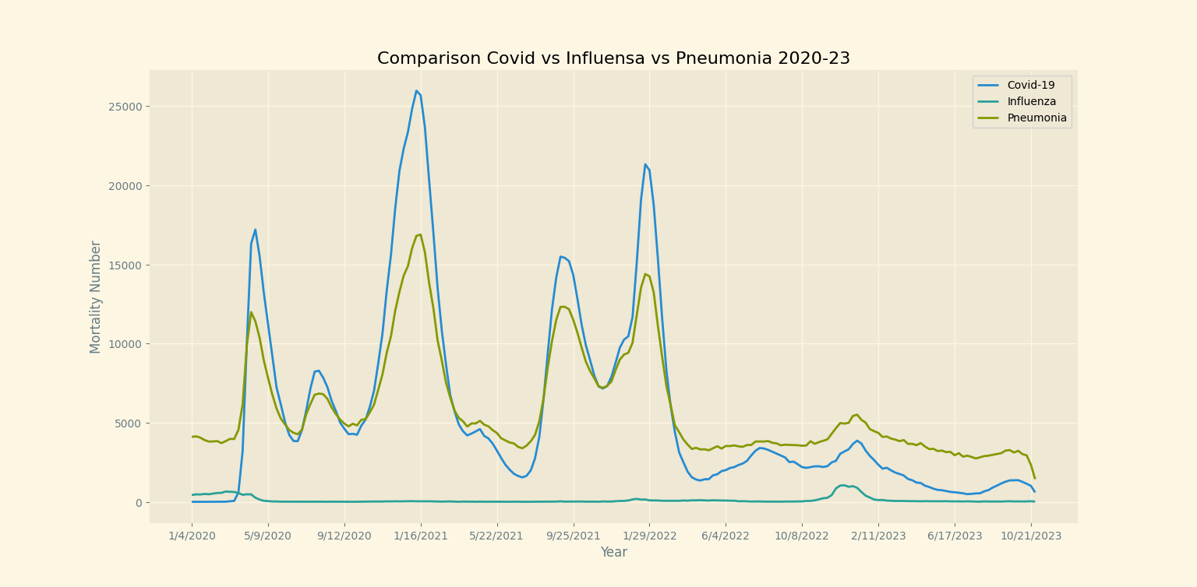
2) Combined results

Slide 8
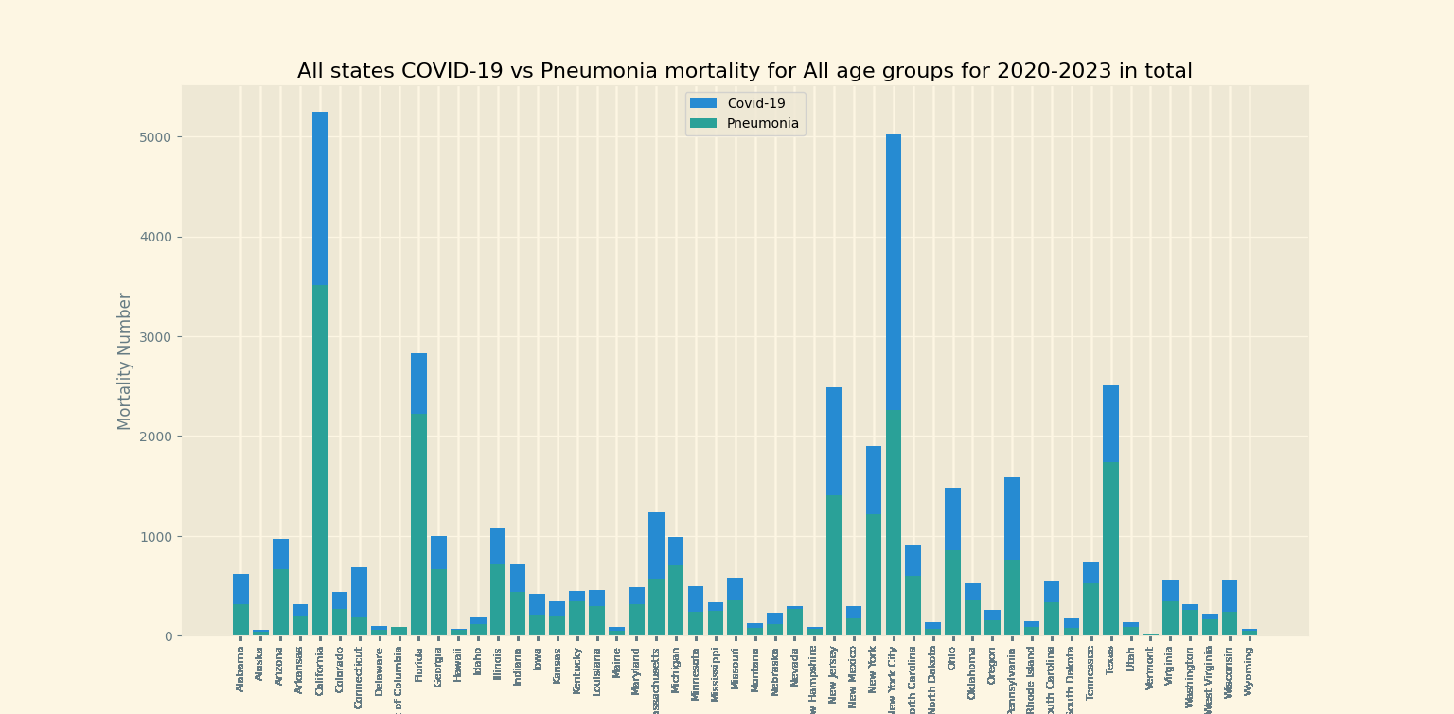
Affected states

Slide 9

Stat Analysis
COVID-19 vs Pneumonia
Mean
COVID-19 is 5757
Pneumonia is 5895
Median
COVID-19 is 3239
Pneumonia is 4534
Mode
COVID-19 is [0.0, 6.0, 2194.0]
Pneumonia is [3810.0]
Range
COVID-19 is 25974
Pneumonia is 15450
IQR
COVID-19 is 6454
Pneumonia is 3662
Variance
Population
COVID-19 is 36102375
Pneumonia is 11150872
Sample
COVID-19 is 36283794
Pneumonia is 11206906
SD
Population
COVID-19 is 6008
Pneumonia is 3339
Sample
COVID-19 is 6023
Pneumonia is 3347

Slide 10

Conclusions
01
02
03
According to the graphs and statistics, COVID-19 was bringing almost double numbers of deaths among other respiratory illness.
The 3 most effected by COVID-19 and Pneumonia locations were New York City, California and Florida.
The least effected by COVID-19 and Pneumonia areas were Alaska, Hawaii and Vermont.

Slide 11


Thank
you!
Should you have any questions, please reach out to Luiza Novytska at
novytska@unlv.nevada.edu

